Slide 1


Tree based Machine Learning Models for Data Science
Session-1
Dr Dheeraj Rathee
Chief Technology and Analytics Officer Provide Digital dheeraj.rathee@nhs.net dheeraj.rathee@providedigital.com

Slide 2
9:30 – 10:30
Decision Trees + Coding
10:30 – 11:00
Caffeine Time
Topics and Timelines
11:00 – 12:30
Random Forest + Coding
12:30 – 13:30
Eat – Drink – Repeat
13:30 – 15:00
Gradient Boosting + Coding
15:00 – 15:30
Caffeine Time
15:30 – 17:00
Data-decoding & Chat

Slide 3


Decision
Trees

Slide 4
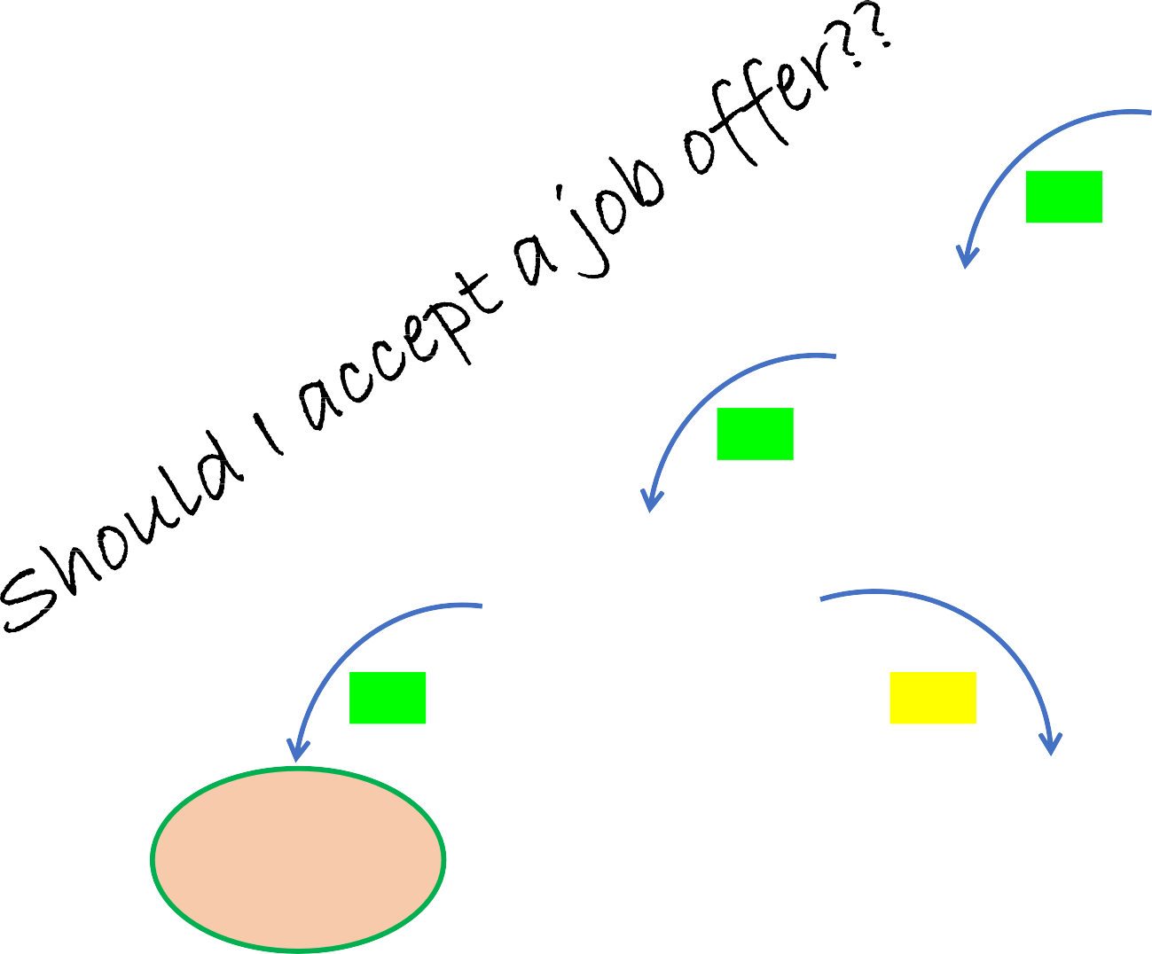


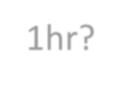

root node
Salary >= £50K?
True
False
Commute < 1hr?
Decline Offer
True
False
decision nodes
Free Coffee?
Decline
Offer
True
False
Accept Offer
Decline Offer
leaf nodes

Slide 5
Let’s create a decision tree using
a raw table of data.
Often Feeling Tired | Blurred Vision | Losing Weight | Diabetes
No | No | No | No
Yes | Yes | Yes | Yes
Yes | Yes | No | No
Yes | No |  | Yes
… | … | … | …

Slide 6
In this example, we want to create a Tree that uses Tired Feeling, blurred Vision and weight loss to predict whether or not the patient is diabetic.
 | Often Feeling Tired | Blurred Vision | Losing Weight |  | Diabetes
 | No | No | No |  | No
 | Yes | Yes | Yes |  | Yes
 | Yes | Yes | No |  | No
 | Yes | No |  |  | Yes
 | … | … | … |  | …

Slide 7
Tired Feeling ? blurred Vision ? weight loss ?
Often Feeling Tired | Blurred Vision | Losing Weight |  | Diabetes
No | No | No |  | No
Yes | Yes | Yes |  | Yes
Yes | Yes | No |  | No
Yes | No |  |  | Yes
… | … | … |  | …
???

Slide 8
Feeling Tired feature
 | Often Feeling Tired |  | Blurred Vision | Losing Weight |  | Diabetes
 | No |  | No | No |  | No
 | Yes |  | Yes | Yes |  | Yes
 | Yes |  | Yes | No |  | No
 | Yes |  | No |  |  | Yes
 | … |  | … | … |  | …

Slide 9
 | Often Feeling Tired |  | Blurred Vision | Losing Weight |  | Diabetes
 | No |  | No | No |  | No
 | Yes |  | Yes | Yes |  | Yes
 | Yes |  | Yes | No |  | No
 | Yes |  | No |  |  | Yes
 | … |  | … | … |  | …
Often Feeling Tired
True
False
Diabetes Yes No
Diabetes
Yes No

Slide 10
The first patient does not feel Tired often and does not have Diabetes.
Often Feeling Tired | Blurred Vision | Losing Weight | Diabetes
No | No | No | No
Yes | Yes | Yes | Yes
Yes | Yes | No | No
Yes | No |  | Yes
… | … | … | …
Often Feeling Tired
True
False
Diabetes Yes No
Diabetes
Yes No

Slide 11
The first patient does not feel Tired often
and does not have Diabetes.
Often Feeling Tired | Blurred Vision | Losing Weight | Diabetes
No | No | No | No
Yes | Yes | Yes | Yes
Yes | Yes | No | No
Yes | No |  | Yes
… | … | … | …
Often Feeling Tired
True
False
Diabetes Yes No
Diabetes
Yes
No
1

Slide 12
The second patient does feel
tired often and also have Diabetes.
Often Feeling Tired | Blurred Vision | Losing Weight | Diabetes
No | No | No | No
Yes | Yes | Yes | Yes
Yes | Yes | No | No
Yes | No |  | Yes
… | … | … | …
Often Feeling Tired
True
False
Diabetes Yes No
Diabetes
Yes
No
1

Slide 13
The second patient does feel
tired often and also have Diabetes.
Often Feeling Tired | Blurred Vision | Losing Weight | Diabetes
No | No | No | No
Yes | Yes | Yes | Yes
Yes | Yes | No | No
Yes | No |  | Yes
… | … | … | …
Often Feeling Tired
True
False
Diabetes Yes No
1
Diabetes
Yes
No
1

Slide 14
The third patient does feel tired
often and but does not have Diabetes.
Often Feeling Tired | Blurred Vision | Losing Weight | Diabetes
No | No | No | No
Yes | Yes | Yes | Yes
Yes | Yes | No | No
Yes | No |  | Yes
… | … | … | …
Often Feeling Tired
True
False
Diabetes
Diabetes
Yes 1
No 1
Yes
No
1

Slide 15
The fourth patient does feel tired
often and does have diabetes.
Often Feeling Tired | Blurred Vision | Losing Weight | Diabetes
No | No | No | No
Yes | Yes | Yes | Yes
Yes | Yes | No | No
Yes | No |  | Yes
… | … | … | …
Often Feeling Tired
True
False
Diabetes
Diabetes
Yes 2
No 1
Yes
No
1

Slide 16
We follow the same process for rest of the data To look at feeling tired feature and diabetes.
Often Feeling Tired | Blurred Vision | Losing Weight | Diabetes
No | No | No | No
Yes | Yes | Yes | Yes
Yes | Yes | No | No
Yes | No |  | Yes
… | … | … | …
Often Feeling Tired
True
False
Diabetes
Diabetes
Yes 105
No 39
Yes
34
No
125

Slide 17
Now we do the exact same thing
For Blurred Vision feature.
Often Feeling Tired | Blurred Vision | Losing Weight | Diabetes
No | No | No | No
Yes | Yes | Yes | Yes
Yes | Yes | No | No
Yes | No |  | Yes
… | … | … | …
Blurred Vision
True
False
Diabetes Yes No
Diabetes
Yes
No
1

Slide 18
Now we do the exact same thing
For Blurred Vision feature.
Often Feeling Tired | Blurred Vision | Losing Weight | Diabetes
No | No | No | No
Yes | Yes | Yes | Yes
Yes | Yes | No | No
Yes | No |  | Yes
… | … | … | …
Blurred Vision
True
False
Diabetes Yes No
1
Diabetes
Yes
No
1

Slide 19
Now we do the exact same thing
For Blurred Vision feature.
Often Feeling Tired | Blurred Vision | Losing Weight | Diabetes
No | No | No | No
Yes | Yes | Yes | Yes
Yes | Yes | No | No
Yes | No |  | Yes
… | … | … | …
Blurred Vision
True
False
Diabetes
Diabetes
Yes 37
No 127
Yes
100
No
33

Slide 20
And… we do the exact same thing
for Losing weight feature.
Often Feeling Tired | Blurred Vision | Losing Weight | Diabetes
No | No | No | No
Yes | Yes | Yes | Yes
Yes | Yes | No | No
Yes | No |  | Yes
… | … | … | …
Losing Weight
True
False
Diabetes
Diabetes
Yes 92
No 37
Yes
45
No
129

Slide 21
Tired Feeling ? blurred Vision ? weight loss ?
Remember!!!
 | Often Feeling Tired | Blurred Vision | Losing Weight | Diabetes
 | No | No | No | No
 | Yes | Yes | Yes | Yes
 | Yes | Yes | No | No
 | Yes | No |  | Yes
 | … | … | … | …
???

Slide 22
Often Feeling Tired
True
False
Diabetes
Diabetes
Yes 105
No 39
Yes 34
No 125
Often Feeling Tired |  |  | Diabetes
No |  |  | No
Yes |  |  | Yes
Yes |  |  | No
Yes |  |  | Yes
… |  |  | …
Blurred
Vision
No Yes Yes
No
…
Losing
Weight
No Yes No
…

Slide 23
Often Feeling Tired
True
False
Diabetes
Diabetes
Yes 105
No 39
Yes 34
No 125
 | Blurred Vision |  | Diabetes
 | No |  | No
 | Yes |  | Yes
 | Yes |  | No
 | No |  | Yes
 | … |  | …
Blurred Vision
Often
Feeling Tired
No
Yes Yes Yes
…
Losing
Weight
No Yes No
…
True
False
Diabetes
Diabetes
Yes 37
No 127
Yes 100
No 33

Slide 24
Often Feeling Tired
True
False
Diabetes
Diabetes
Yes 105
No 39
Yes 34
No 125
 |  | Losing Weight | Diabetes
 |  | No | No
 |  | Yes | Yes
 |  | No | No
 |  |  | Yes
 |  | … | …
Blurred Vision
Often
Feeling Tired
No
Yes Yes Yes
…
Blurred
Vision
No Yes Yes
No
…
True
False
Diabetes
Diabetes
Yes 37
No 127
Yes 100
No 33
Losing Weight
True
False
Diabetes
Diabetes
Yes
92
No
37
Yes
45
No
129

Slide 25
Often Feeling Tired
True
False
Diabetes
Diabetes
Because none of the leaf nodes are 100% ‘pure’ i.e. having either all ‘Yes’ cases or ‘No’ cases, they Are considered as ‘impure’
Yes 105
No 39
Yes 34
No 125
Blurred Vision
True
False
Diabetes
Diabetes
Yes 37
No 127
Yes 100
No 33
To measure which feature is best, we need to compare their impurities by estimating ‘GINI’ index.
Losing Weight
True
False
• Information gain
• Entropy
• MSE
Diabetes
Diabetes
Yes
92
No
37
Yes
45
No
129

Slide 26
Let’s calculate the Gini impurity for feeling tired feature…
Often Feeling Tired
True
False
Diabetes
Diabetes
Yes 105
No 39
Yes 34
No 125
Gini (FT=true) = 1 − (𝑃𝑟𝑜𝑏 𝑜𝑓 ′𝑦𝑒𝑠′)² − (𝑃𝑟𝑜𝑏 𝑜𝑓 ′𝑛𝑜′)²
Gini (FT=true) = 1 − (
105
₎2
− (
39
₎2
105+39
105+39
Gini (FT=true) = 0.395

Slide 27
Let’s calculate the Gini impurity for feeling tired feature…
Often Feeling Tired
True
False
Diabetes
Diabetes
Yes 105
No 39
Yes 34
No 125
Gini (FT=true) = 0.395

Slide 28
Let’s calculate the Gini impurity for feeling tired feature…
Often Feeling Tired
True
False
Diabetes
Diabetes
Yes 105
No 39
Yes 34
No 125
Gini (FT=true) = 0.395
Gini (FT=false) = 1 − (𝑃𝑟𝑜𝑏 𝑜𝑓 ′𝑦𝑒𝑠′)² − (𝑃𝑟𝑜𝑏 𝑜𝑓 ′𝑛𝑜′)²
Gini (FT= false) = 1 − (
34
₎2
− (
125
₎2
34+125
34+125
Gini (FT= false) = 0.336

Slide 29
Let’s calculate the Gini impurity for feeling tired feature…
Often Feeling Tired
True
False
Diabetes
Diabetes
Yes 105
No 39
Yes 34
No 125
Gini (FT=true) = 0.395
Gini (FT=false) = 0.336
Gini impurity (FT) = 𝑤𝑒𝑖𝑔ℎ𝑡𝑒𝑑 𝑎𝑣𝑔 𝑜𝑓 𝐺𝑖𝑛𝑖 𝑖𝑚𝑝𝑢𝑟𝑖𝑡𝑖𝑒𝑠 𝑜𝑓 𝑙𝑒𝑎𝑓 𝑛𝑜𝑑𝑒𝑠
=
144 159
0.395 + 0.336
144+159 144+159
= 0.364

Slide 30
Often Feeling Tired
True
False
Gini impurity for Feeling tired = 0.364
Diabetes
Yes 105
Diabetes
Yes 34
No 39
No 125
Blurred Vision
True
False
Gini impurity for Blurred Vision= 0.360
Diabetes
Yes 37
Diabetes
Yes 100
No 127
No 33
Losing Weight
Gini impurity for Losing Weight= 0.381
True
False
Diabetes
Diabetes
Yes
92
No
37
Yes
45
No
129

Slide 31
Gini impurity for Feeling tired = 0.364
Gini impurity for Blurred Vision= 0.360
Gini impurity for Losing Weight= 0.381
Blurred
Vision

Slide 32
Blurred Vision
True
False
Diabetes
Diabetes
Yes 37
No 127
Yes 100
No 33
Blurred
Vision

Slide 33
Blurred Vision
True
False
Diabetes
Diabetes
Yes 37
No 127
Yes 100
No 33
Blurred
Vision
37/127
100/33

Slide 34
Feeling Tired
True
False
Diabetes
Diabetes
Yes 13
No 98
Yes 24
No 29
Blurred
Vision
Gini impurity for Feeling tired = 0.3
37/127
100/33

Slide 35
Feeling Tired
True
False
Diabetes
Diabetes
Yes 13
No 98
Yes 24
No 29
Gini impurity for Feeling tired = 0.3
Blurred
Vision
Weight loss
True
False
37/127
100/33
Diabetes
Diabetes
Yes 24
No 25
Yes 13
No 102
Gini impurity for Feeling tired = 0.290

Slide 36
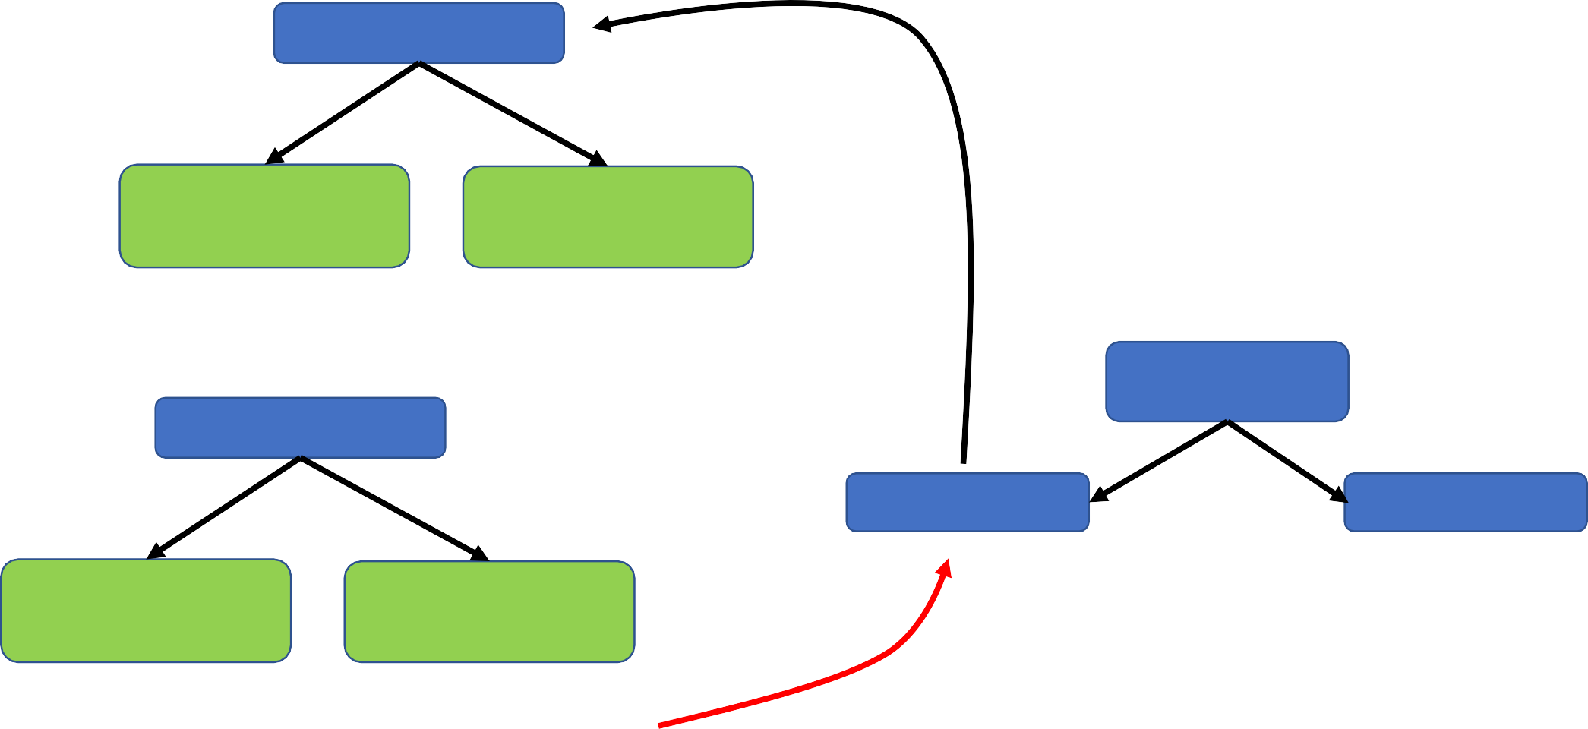
Feeling Tired
True
False
Diabetes
Diabetes
Yes 13
No 98
Yes 24
No 29
Gini impurity for Feeling tired = 0.3
Blurred
Vision
Weight loss
True
False
37/127
100/33
Diabetes
Diabetes
Yes 24
No 25
Yes 13
No 102
Gini impurity for Feeling tired = 0.290

Slide 37
Feeling Tired
True
False
Diabetes
Diabetes
Yes 7
No 26
Yes 6
No 76
Blurred
Vision
Gini impurity for Feeling tired = 0.21
Losing Weight
100/33
Feeling Tr
13/102
17/3
7/22

Slide 38
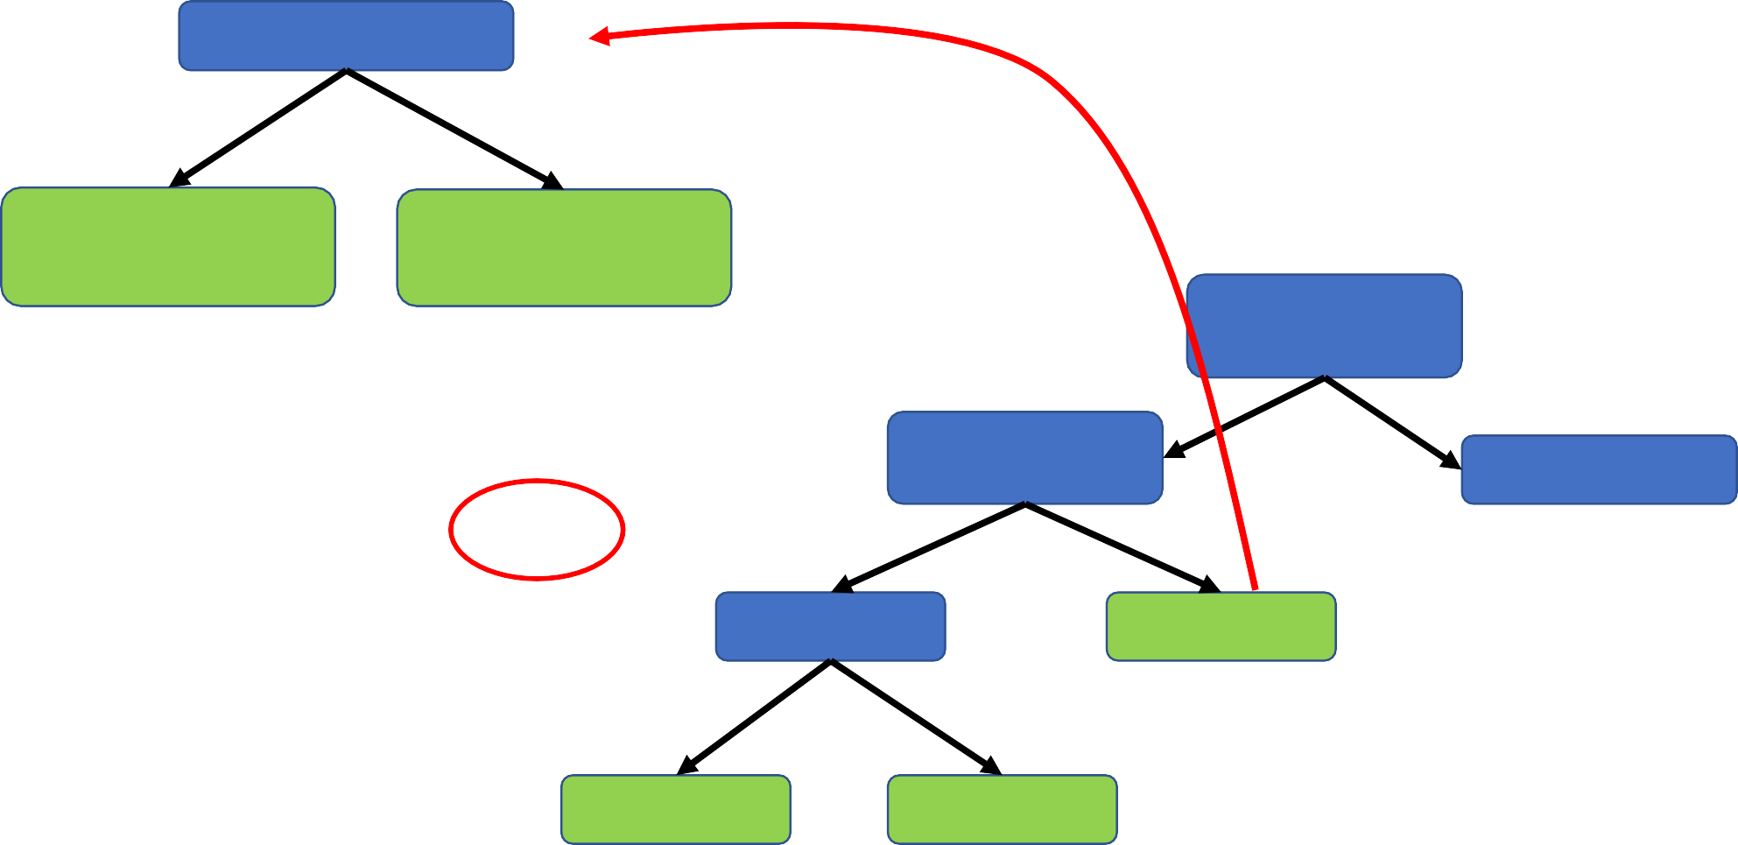
Feeling Tired
True
False
Diabetes
Diabetes
Yes 7
No 26
Yes 6
No 76
Blurred
Vision
Gini impurity for Feeling tired = 0.21
Losing Weight
100/33
Gini impurity for this node= 0.20
Feeling Tr
13/102
17/3
7/22

Slide 39
We follow the exact same steps with
other side as well:
1. Calculate all the Gini impurity values
2. If the node itself has the lowest value,
then there is no further separation required
and the node become leaf node.
Blurred Vision
Losing Weight
Feeling Tired
3. If separating the data reduce the Gini value, pick the best feature and go ahead,
Feeling Tired
13/102
92/3
Losing Weight
17/3
7/22
8/0
0/30

Slide 40
So far we have made a decision tree with a yes-no data…
What about a numerical data???
Blurred Vision
Losing Weight
Feeling Tired
Feeling Tired
13/102
92/3
Losing Weight
17/3
7/22
8/0
0/30

Slide 41
Sort according to the numerical value
Weight | Diabetes
170 | Yes
190 | Yes
200 | Yes
160 | No
180 | No
Weight | Diabetes
160 | No
170 | Yes
180 | No
190 | Yes
200 | Yes

Slide 42
Calculate the mean for each consecutive feature value.
Weight | Diabetes
170 | Yes
190 | Yes
200 | Yes
160 | No
180 | No
Weight | Diabetes
160 | No
170 | Yes
180 | No
190 | Yes
200 | Yes
Weight | Diabetes
160 | No
170 | Yes
180 | No
190 | Yes
200 | Yes
165
175
185
195

Slide 43
Calculate the mean for each consecutive feature value. Estimate the Gini impurity values for each mean value
as a threshold.
Weight < 165
True
False
Weight | Diabetes
170 | Yes
190 | Yes
200 | Yes
160 | No
180 | No
Weight | Diabetes
160 | No
170 | Yes
180 | No
190 | Yes
200 | Yes
Weight | Diabetes
160 | No
170 | Yes
180 | No
190 | Yes
200 | Yes
Diabetes
Diabetes
Yes 0
No 1
Yes 3
No 1
165
Gini impurity as Threshold
175
Gini impurity as Threshold
185
Gini impurity as Threshold
195
Gini impurity as Threshold

Slide 44
Region: Wales
Region: Wales or England
True
False
True
False
Region | Diabetes
Wales | Yes
England | No
Scotland | Yes
Wales | Yes
England | No
Region: England
Region: Wales or Scotland
True
False
True
False
Region: Scotland
Region: Scotland or England
True
False
True
False

Slide 45
Time to code a Decision tree

Slide 46
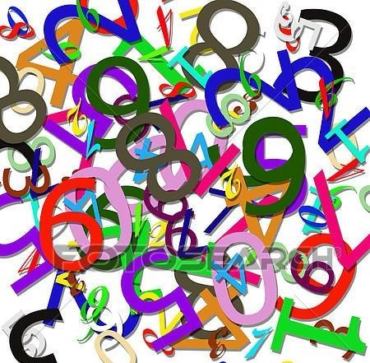
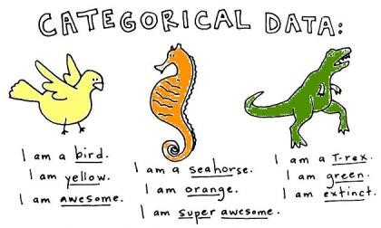

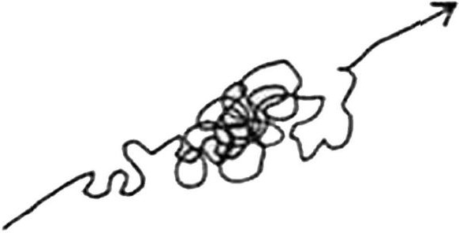
Advantages of Decision Trees
SIMPLE TO UNDERSTAND, INTERPRET & VISUALISE
VARIABLE SCREENING OR FEATURE SELECTION
NUMERICAL & CATEGORICAL DATA
LITTLE EFFORT FOR DATA PREPARATION
EFFECTIVE HANDLING OF NON-LINEAR DATA

Slide 47

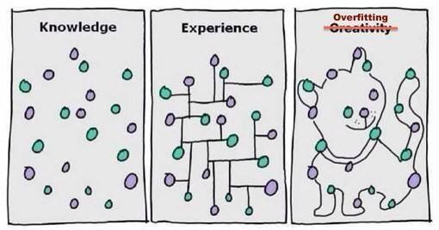

Disadvantages of Decision Trees
PRONE TO OVERFITTING UNSTABILITY
TOWARDS SMALL DATA VARIATIONS
UNEQUAL SAMPLE SIZE CAN CAUSE BIASED TREES

Slide 48
•
Basics of Decision Tree
•
How to create a Decision Tree
•
Estimation of Gini Impurity
Summary
•
Handling categorical, Yes-No, numerical & ranked data
•
Use scikit-learn to implement DT for Iris data
•
Visualise Tree structure and played with parameters

Slide 49
Contact
kťťps://www.li⭲kcdi⭲.com/i⭲/dkccíajíaťkcc/
dkccíaj.íaťkcc@⭲ks.⭲cť

